Slide 1
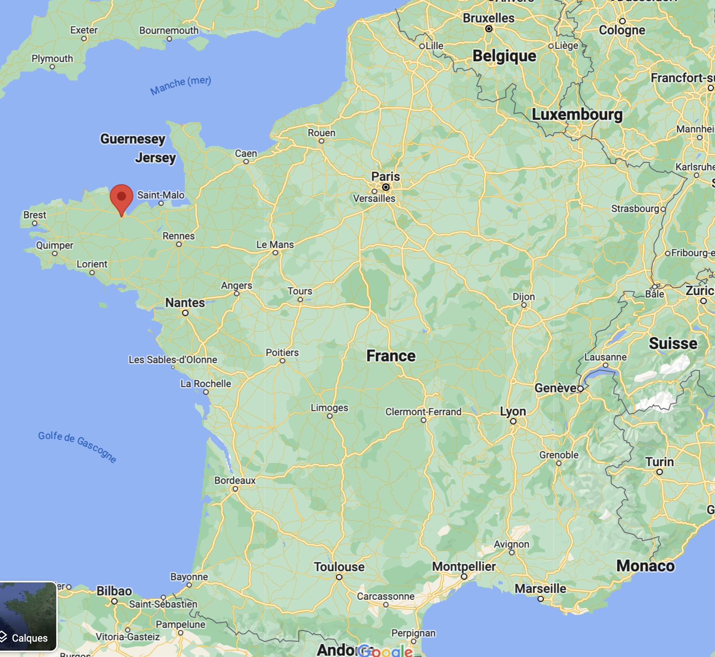

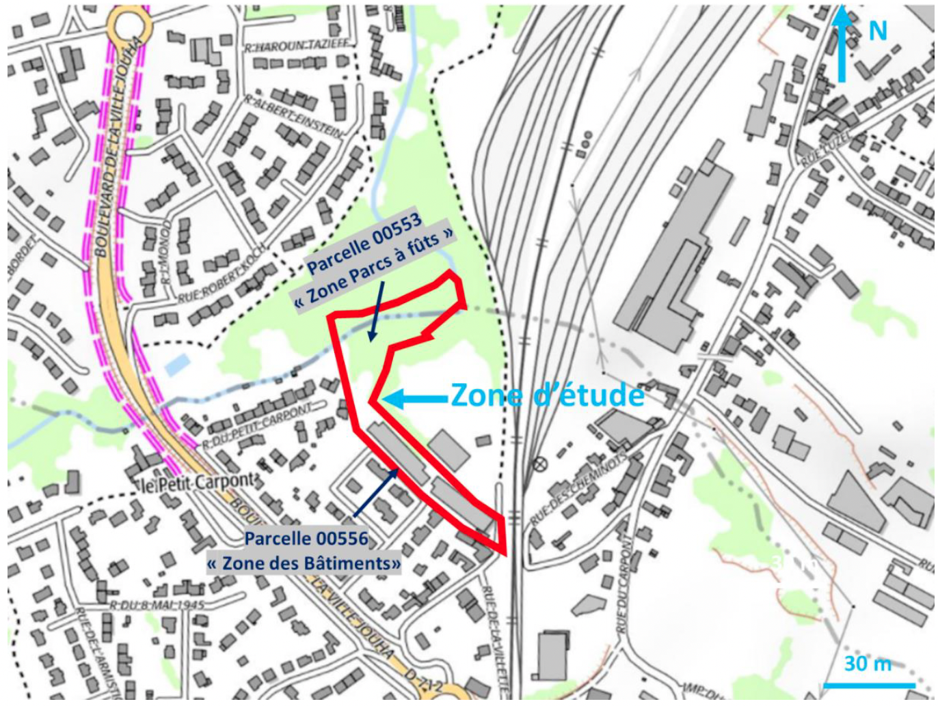
Ploufragran site
History of activities
Ploufragan
Nancy
Located in Brittany (western France)
Housed a soap factory (Le Brochin), encaustic / paint manufacturing activity and used motor oil regeneration activity (Renaud-Lucienne) in the 20th century.
Declared in receivership in 1993 and liquidated in 1994. Recognised as an orphan by the Ministry of the Environment in 1996. ADEME (Agency for the Environment and Energy Management) is taking charge of it on behalf of the French government and must ensure its decontamination.
Buildings demolished in 2017 and the site was fully characterised to assess the contamination in autumn 2021.
Oil drum yard area
Old building area

Slide 2
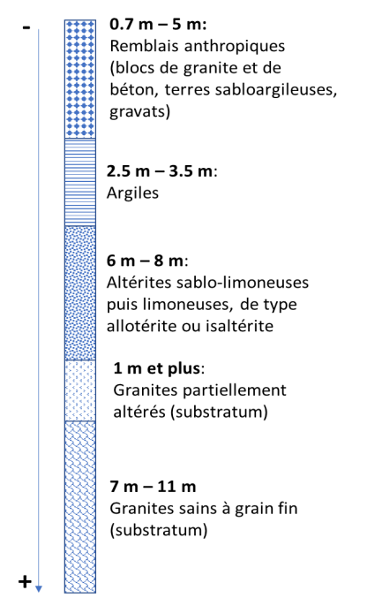
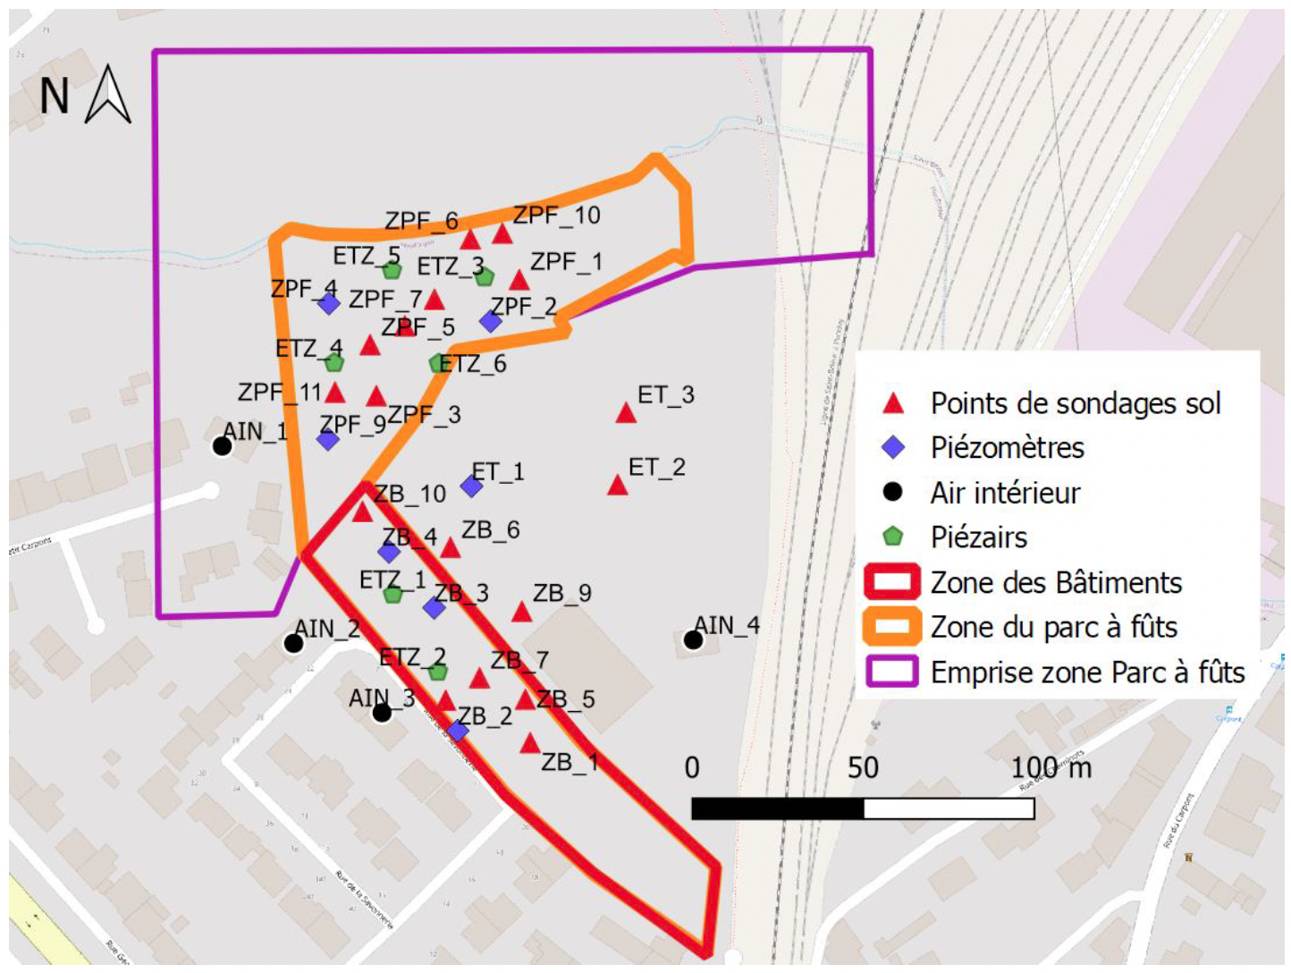
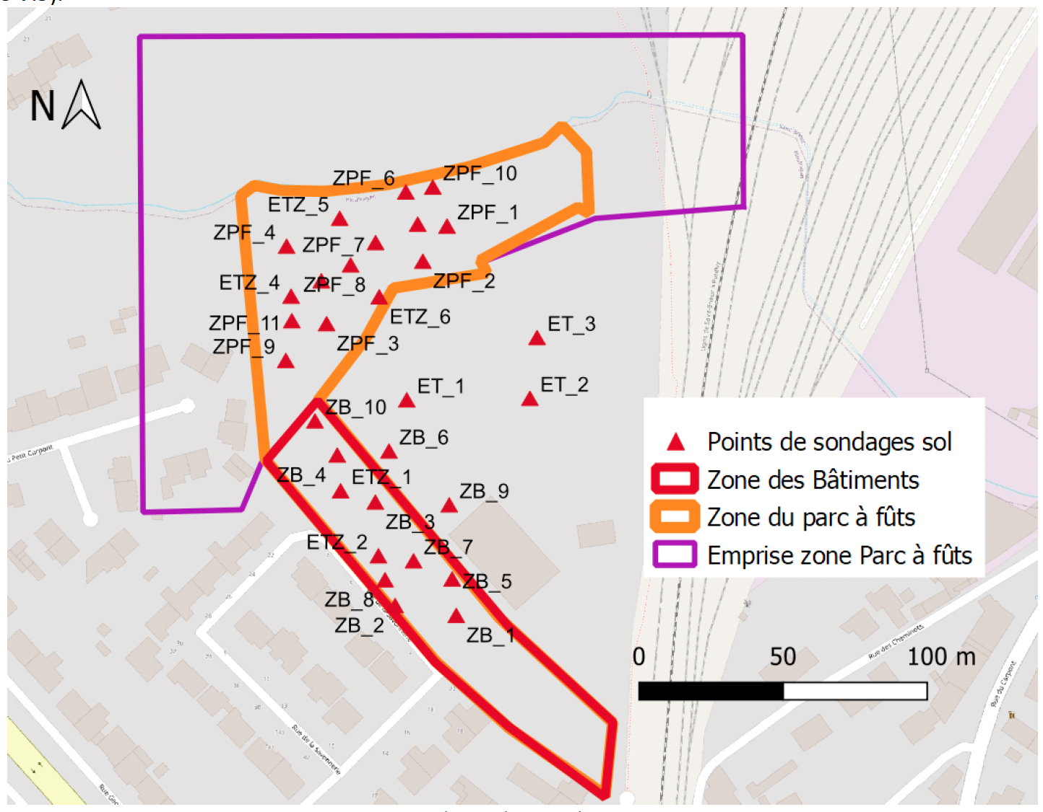
Lithological section
Investigation points in 2021
all
soils
Anthropogenic fill (granite and concrete blocks, sandy-clay soil, rubble)
Ruisseau Jouha
clay
sandy-silty then silty alterites, of the alloterite or isalterite type
partially weathered granites (bedrock)
Hydrology
sound, fine-grained granites (bedrock)
The study area contains two superimposed and independent nappes with different morphological characteristics. These are i) a water table trapped in the alterites with a clayey and capacitive composition, and ii) a water table enclosed in the fractured horizon, which is known to be transmissive (more permeable than the first system). The flow direction of these two reservoirs is from south to north and then east, following the direction of the Ruisseau Jouha.

Slide 3
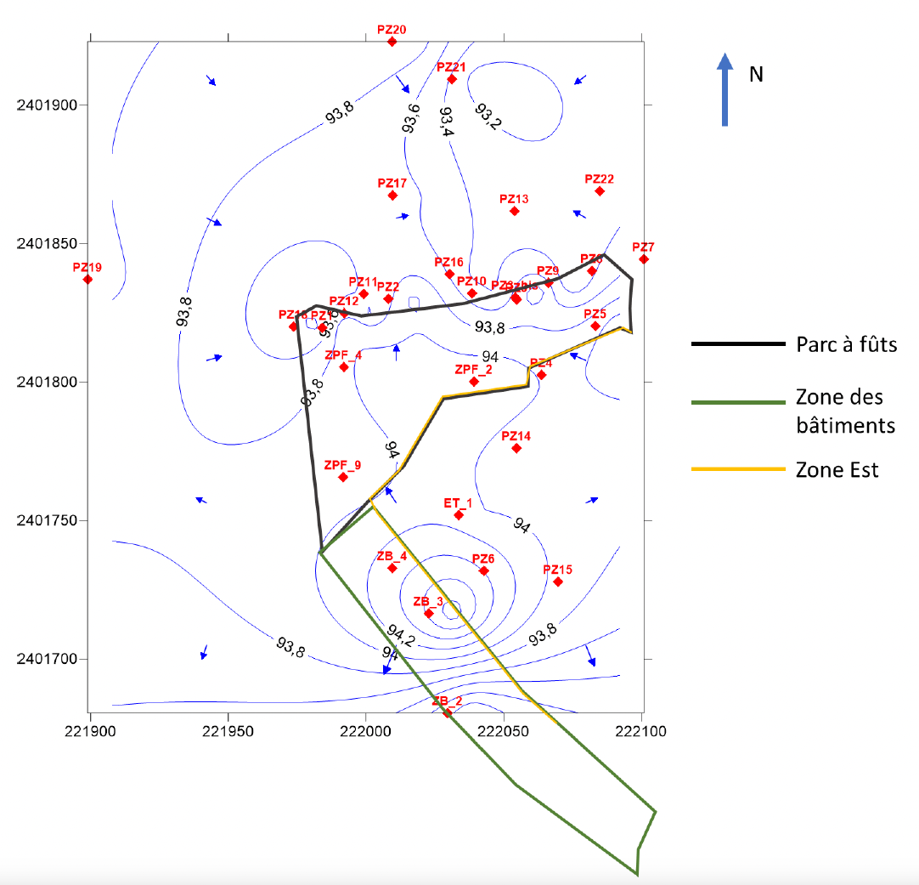
Hydrology
The study area contains two superimposed and independent nappes with different morphological characteristics. These are i) a water table trapped in the alterites with a clayey and capacitive composition, and ii) a water table enclosed in the fractured horizon, which is known to be transmissive (more permeable than the first system). The flow direction of these two reservoirs is from south to north and then east, following the direction of the Ruisseau Jouha.
Watertable level and sens of water flow

Slide 4
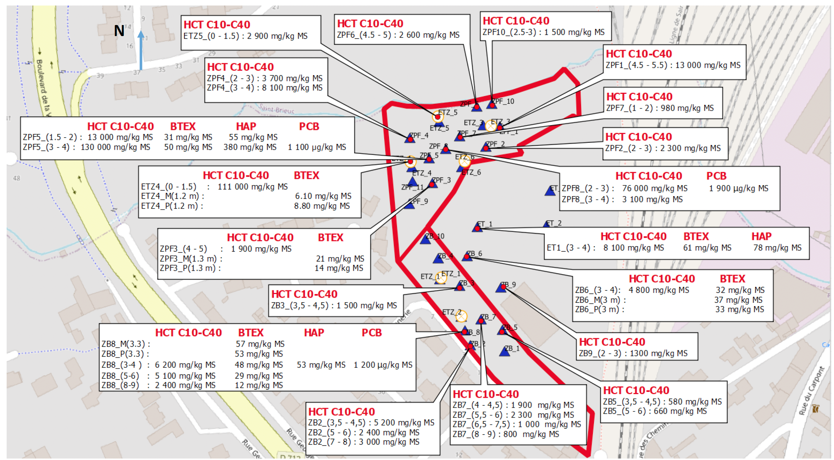
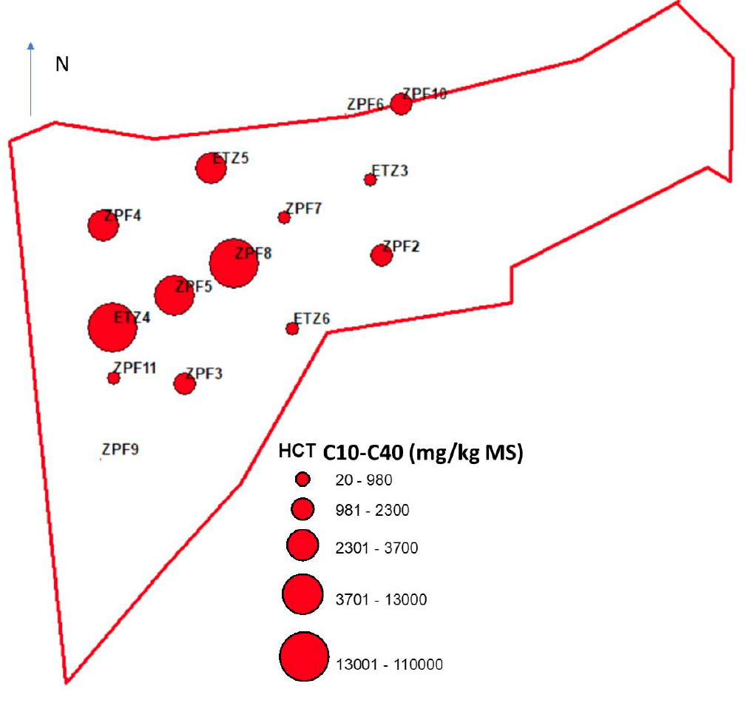
Soil TPH contamination
0-3m depth

Slide 5
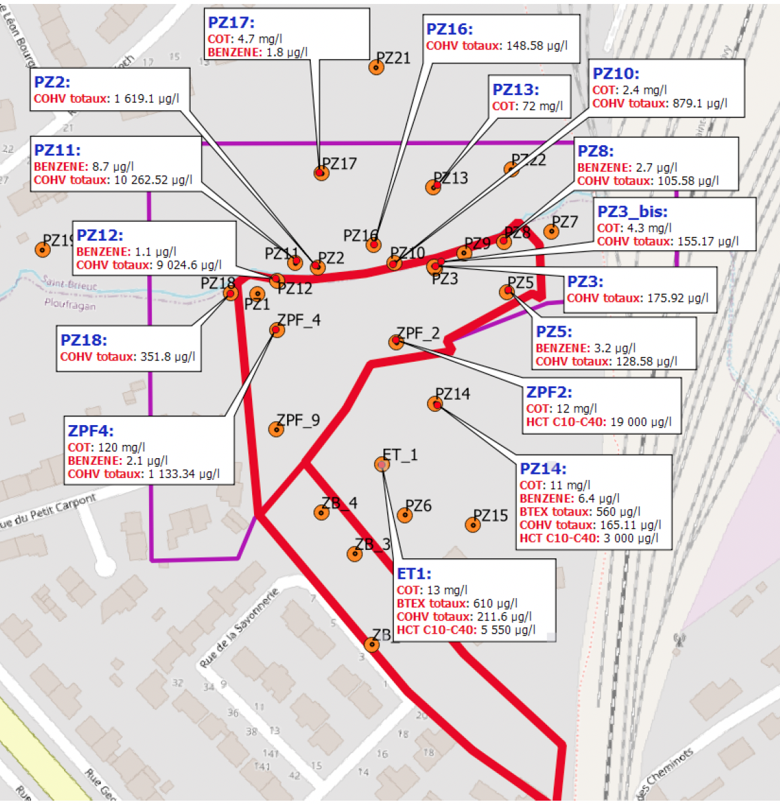
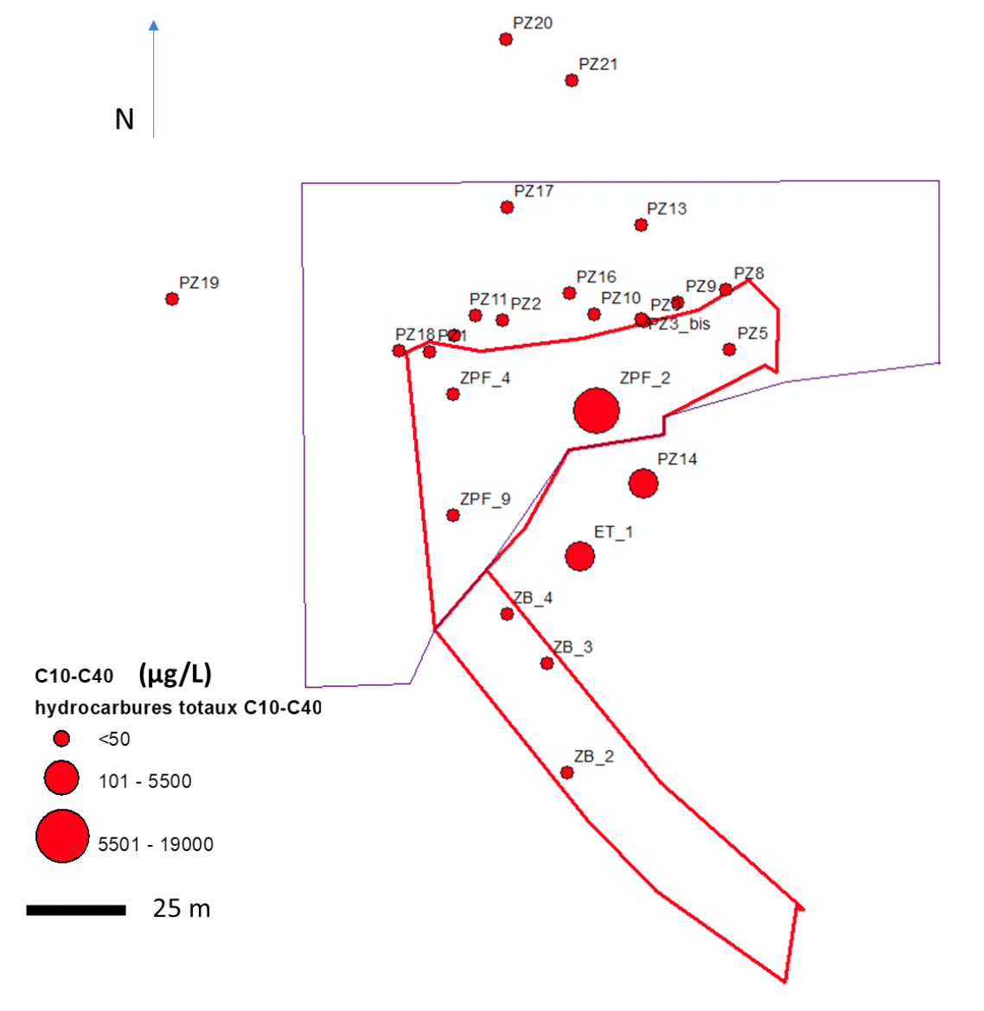
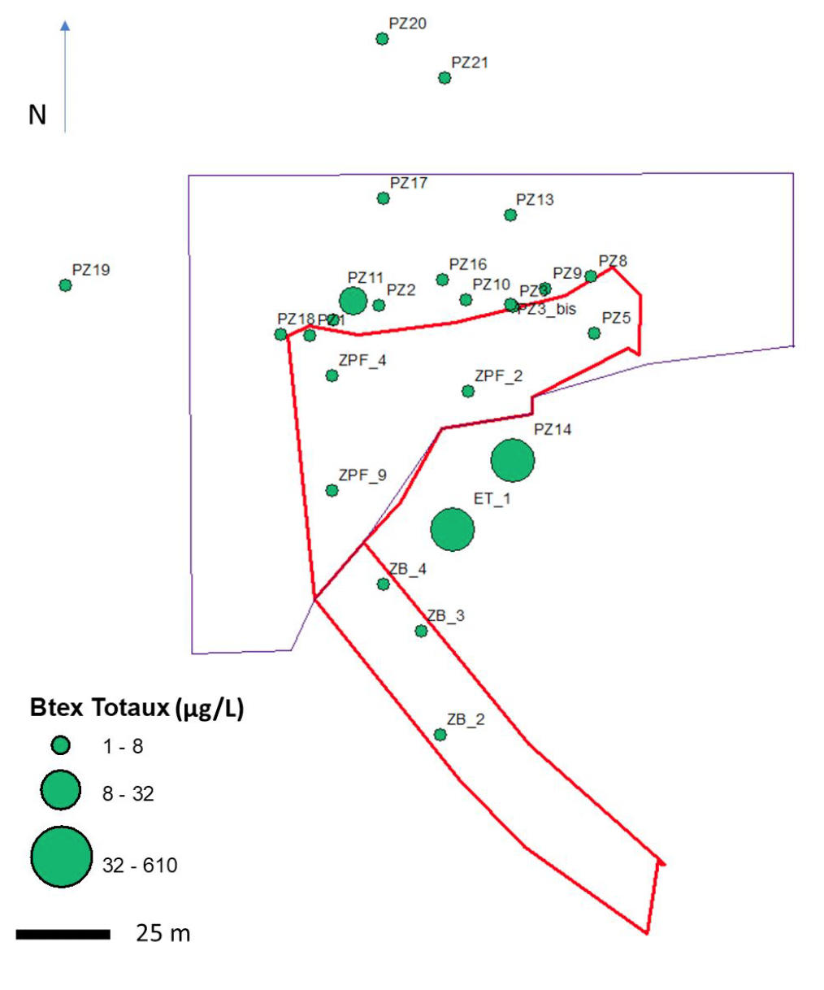
Groundwater PHC contamination

Slide 6
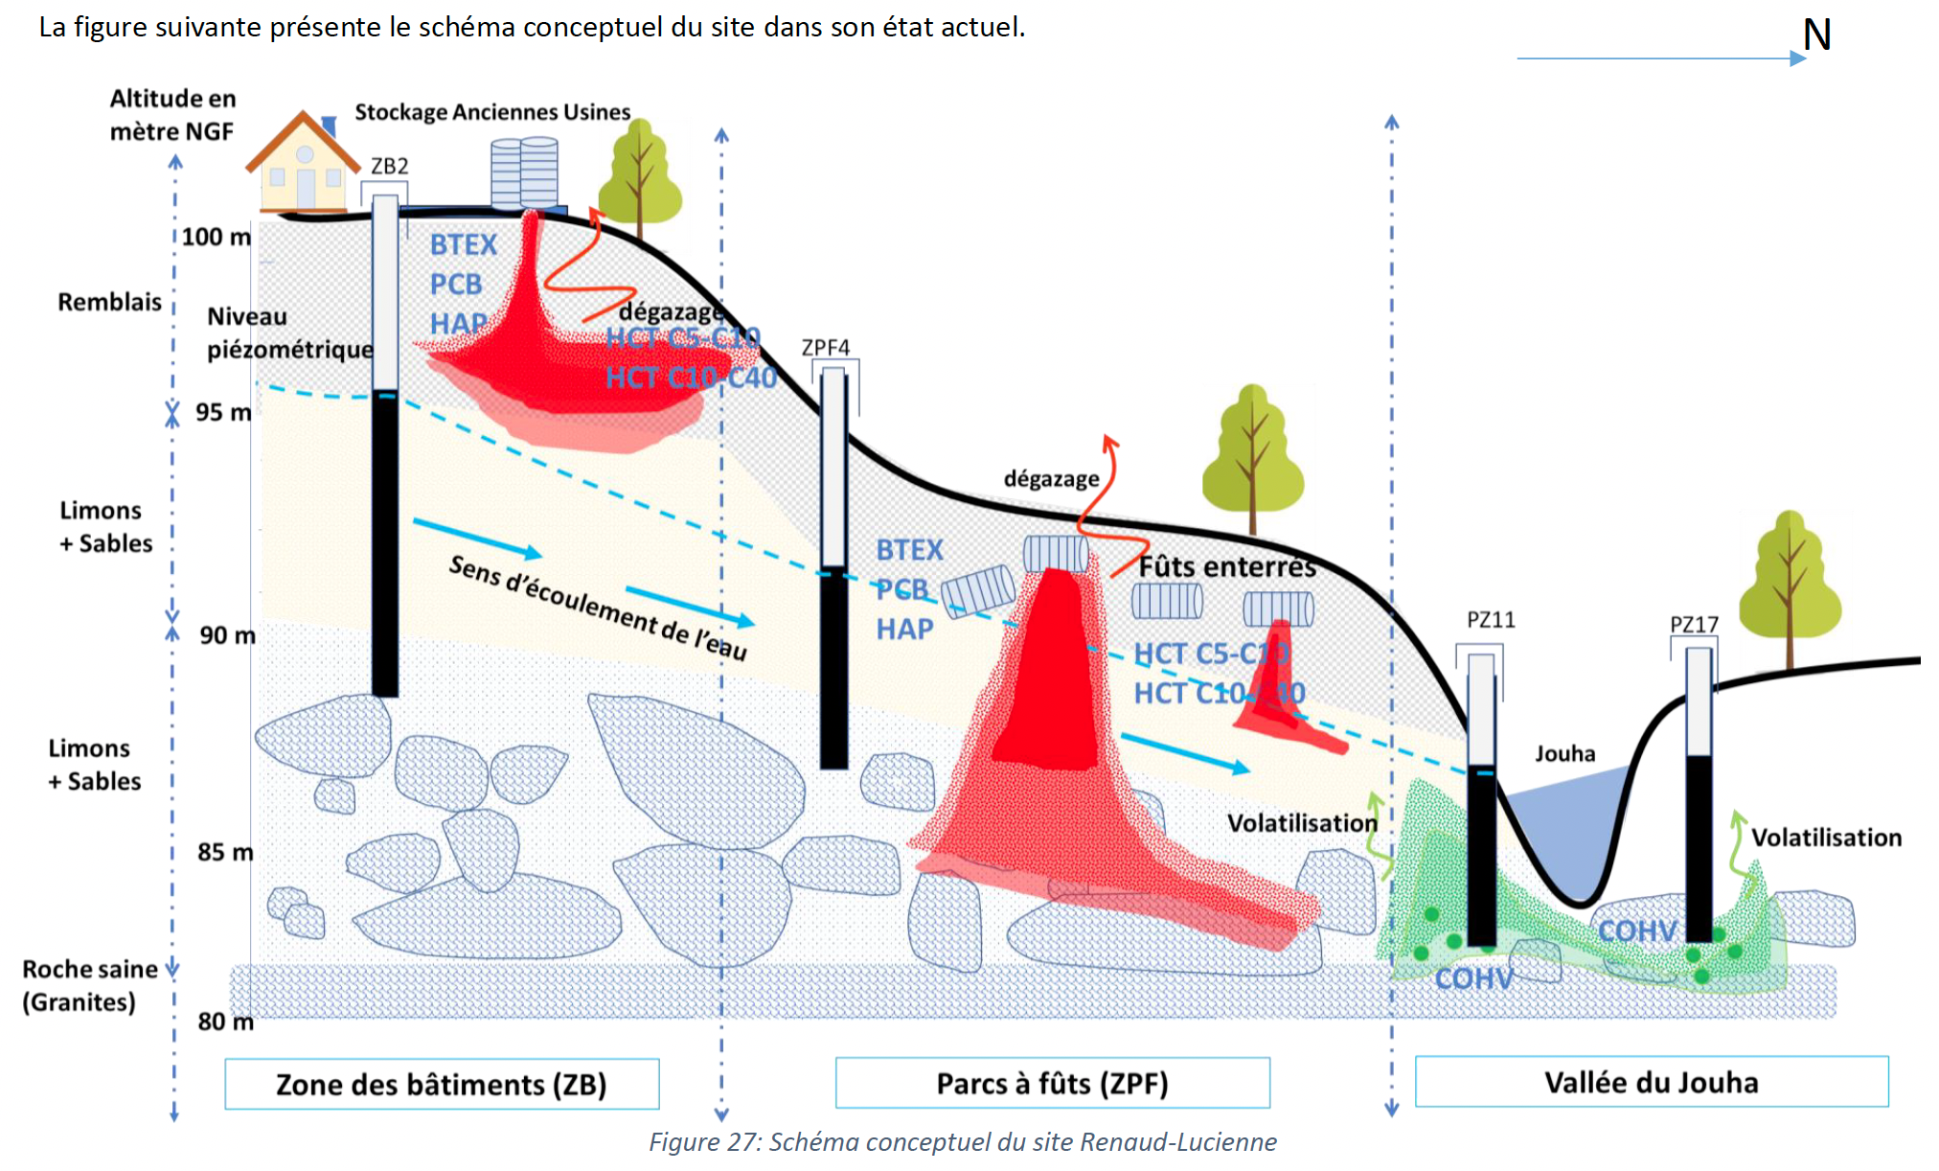
Conceptual site diagram

Slide 7
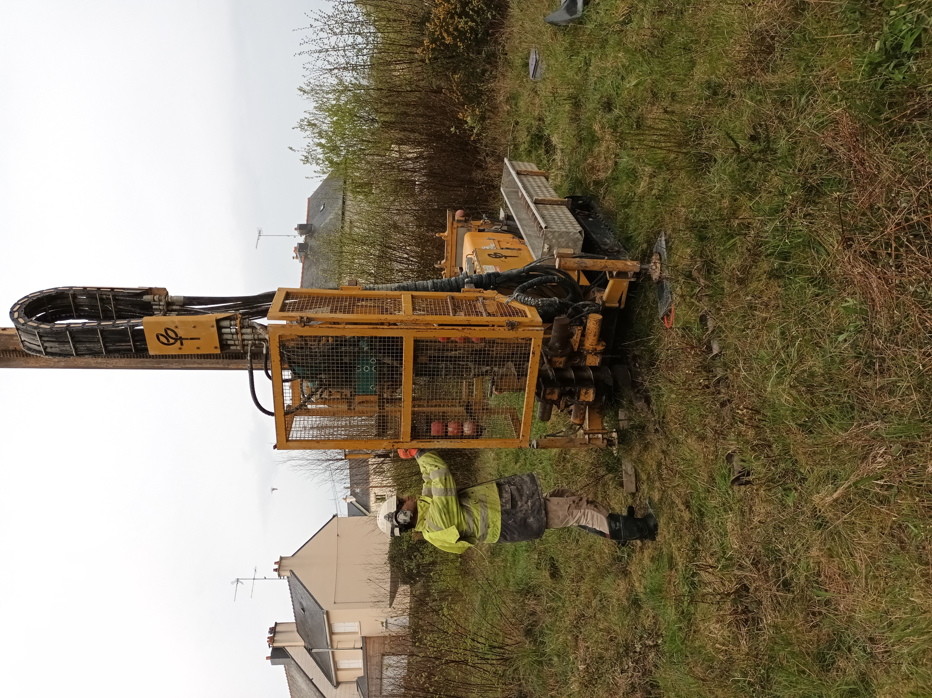
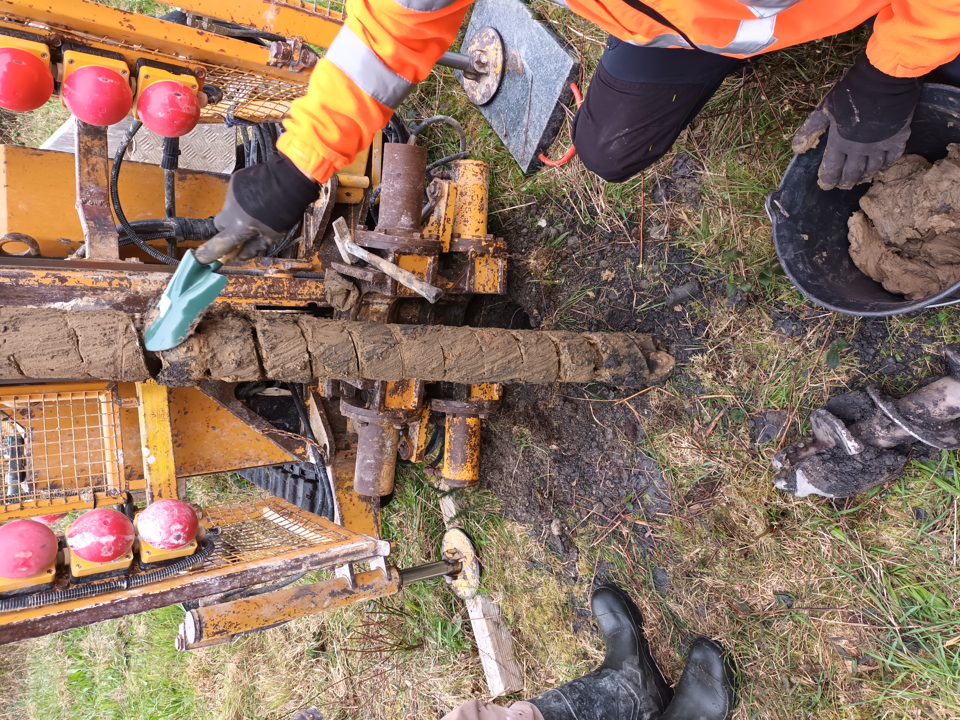
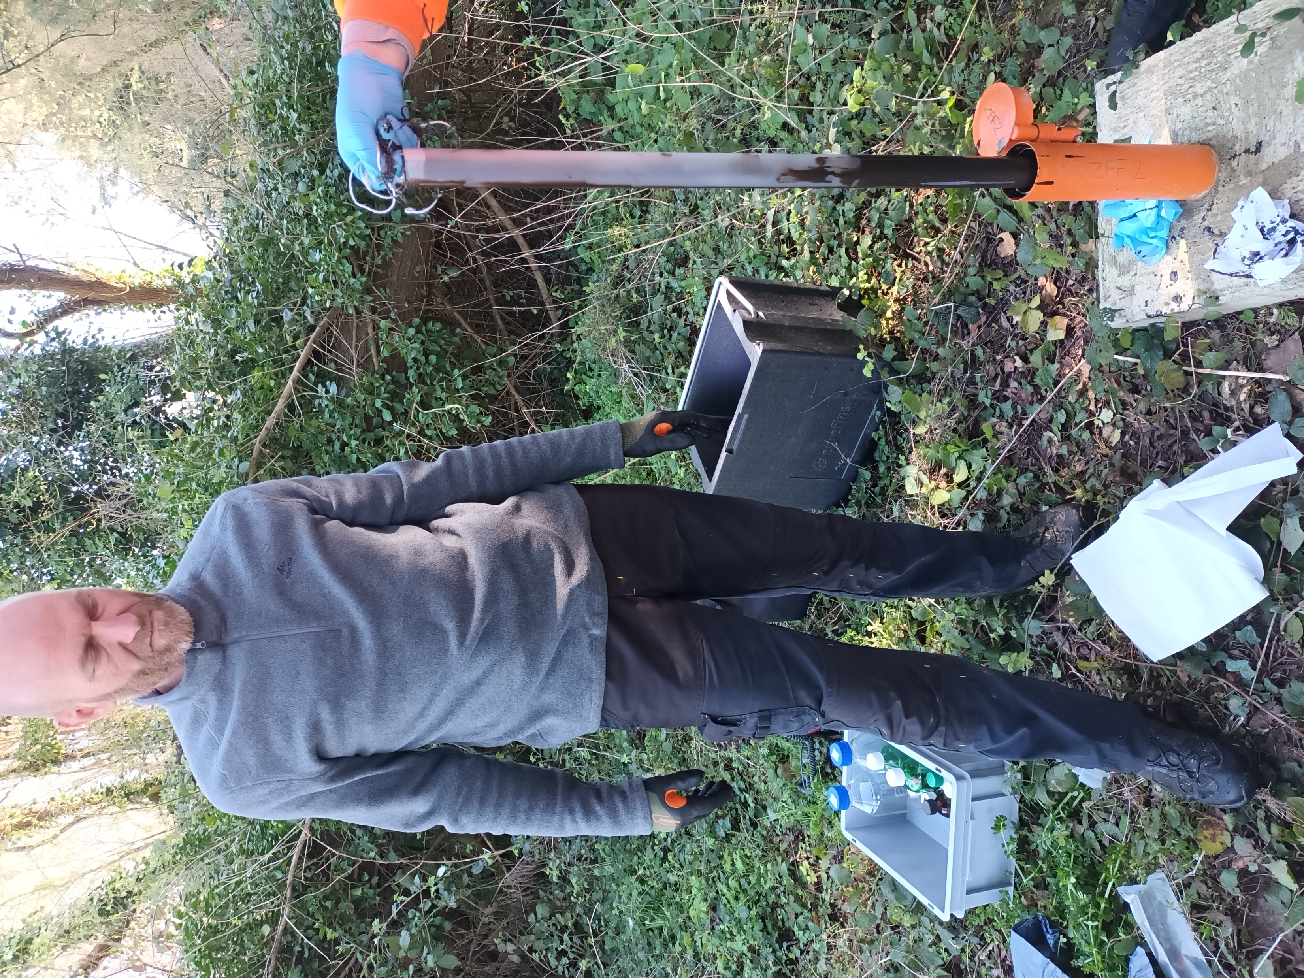
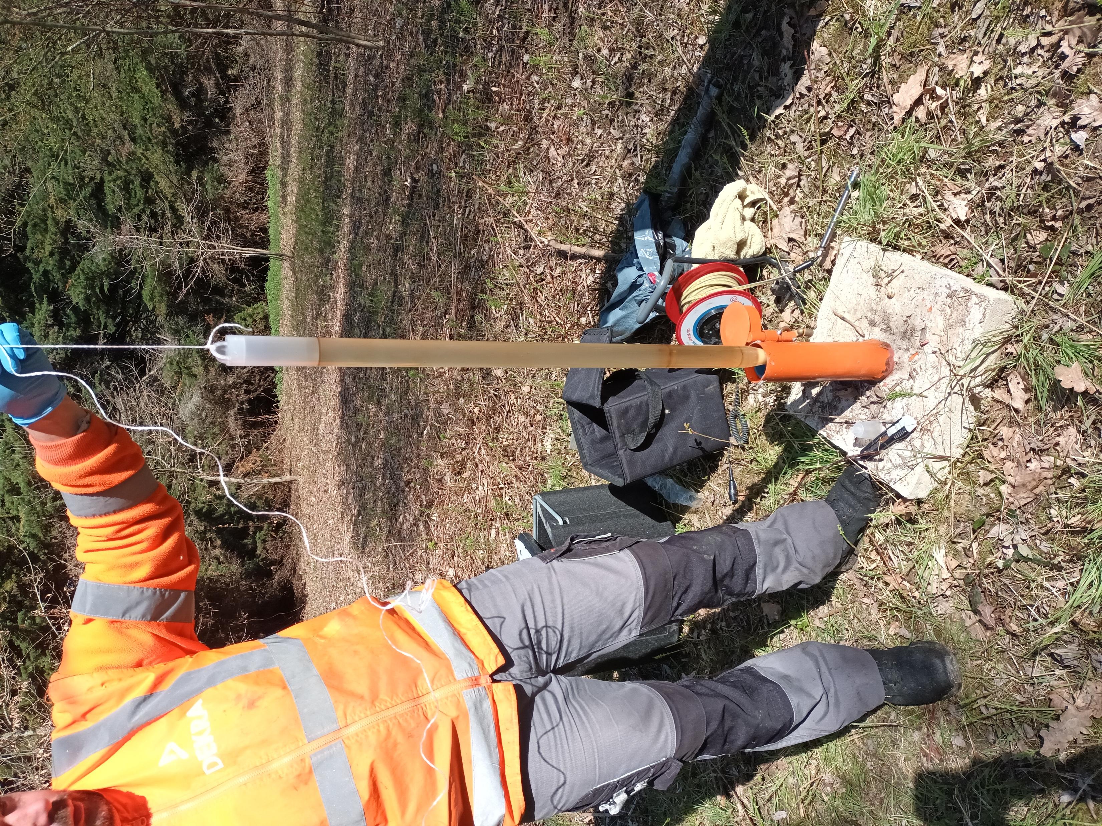
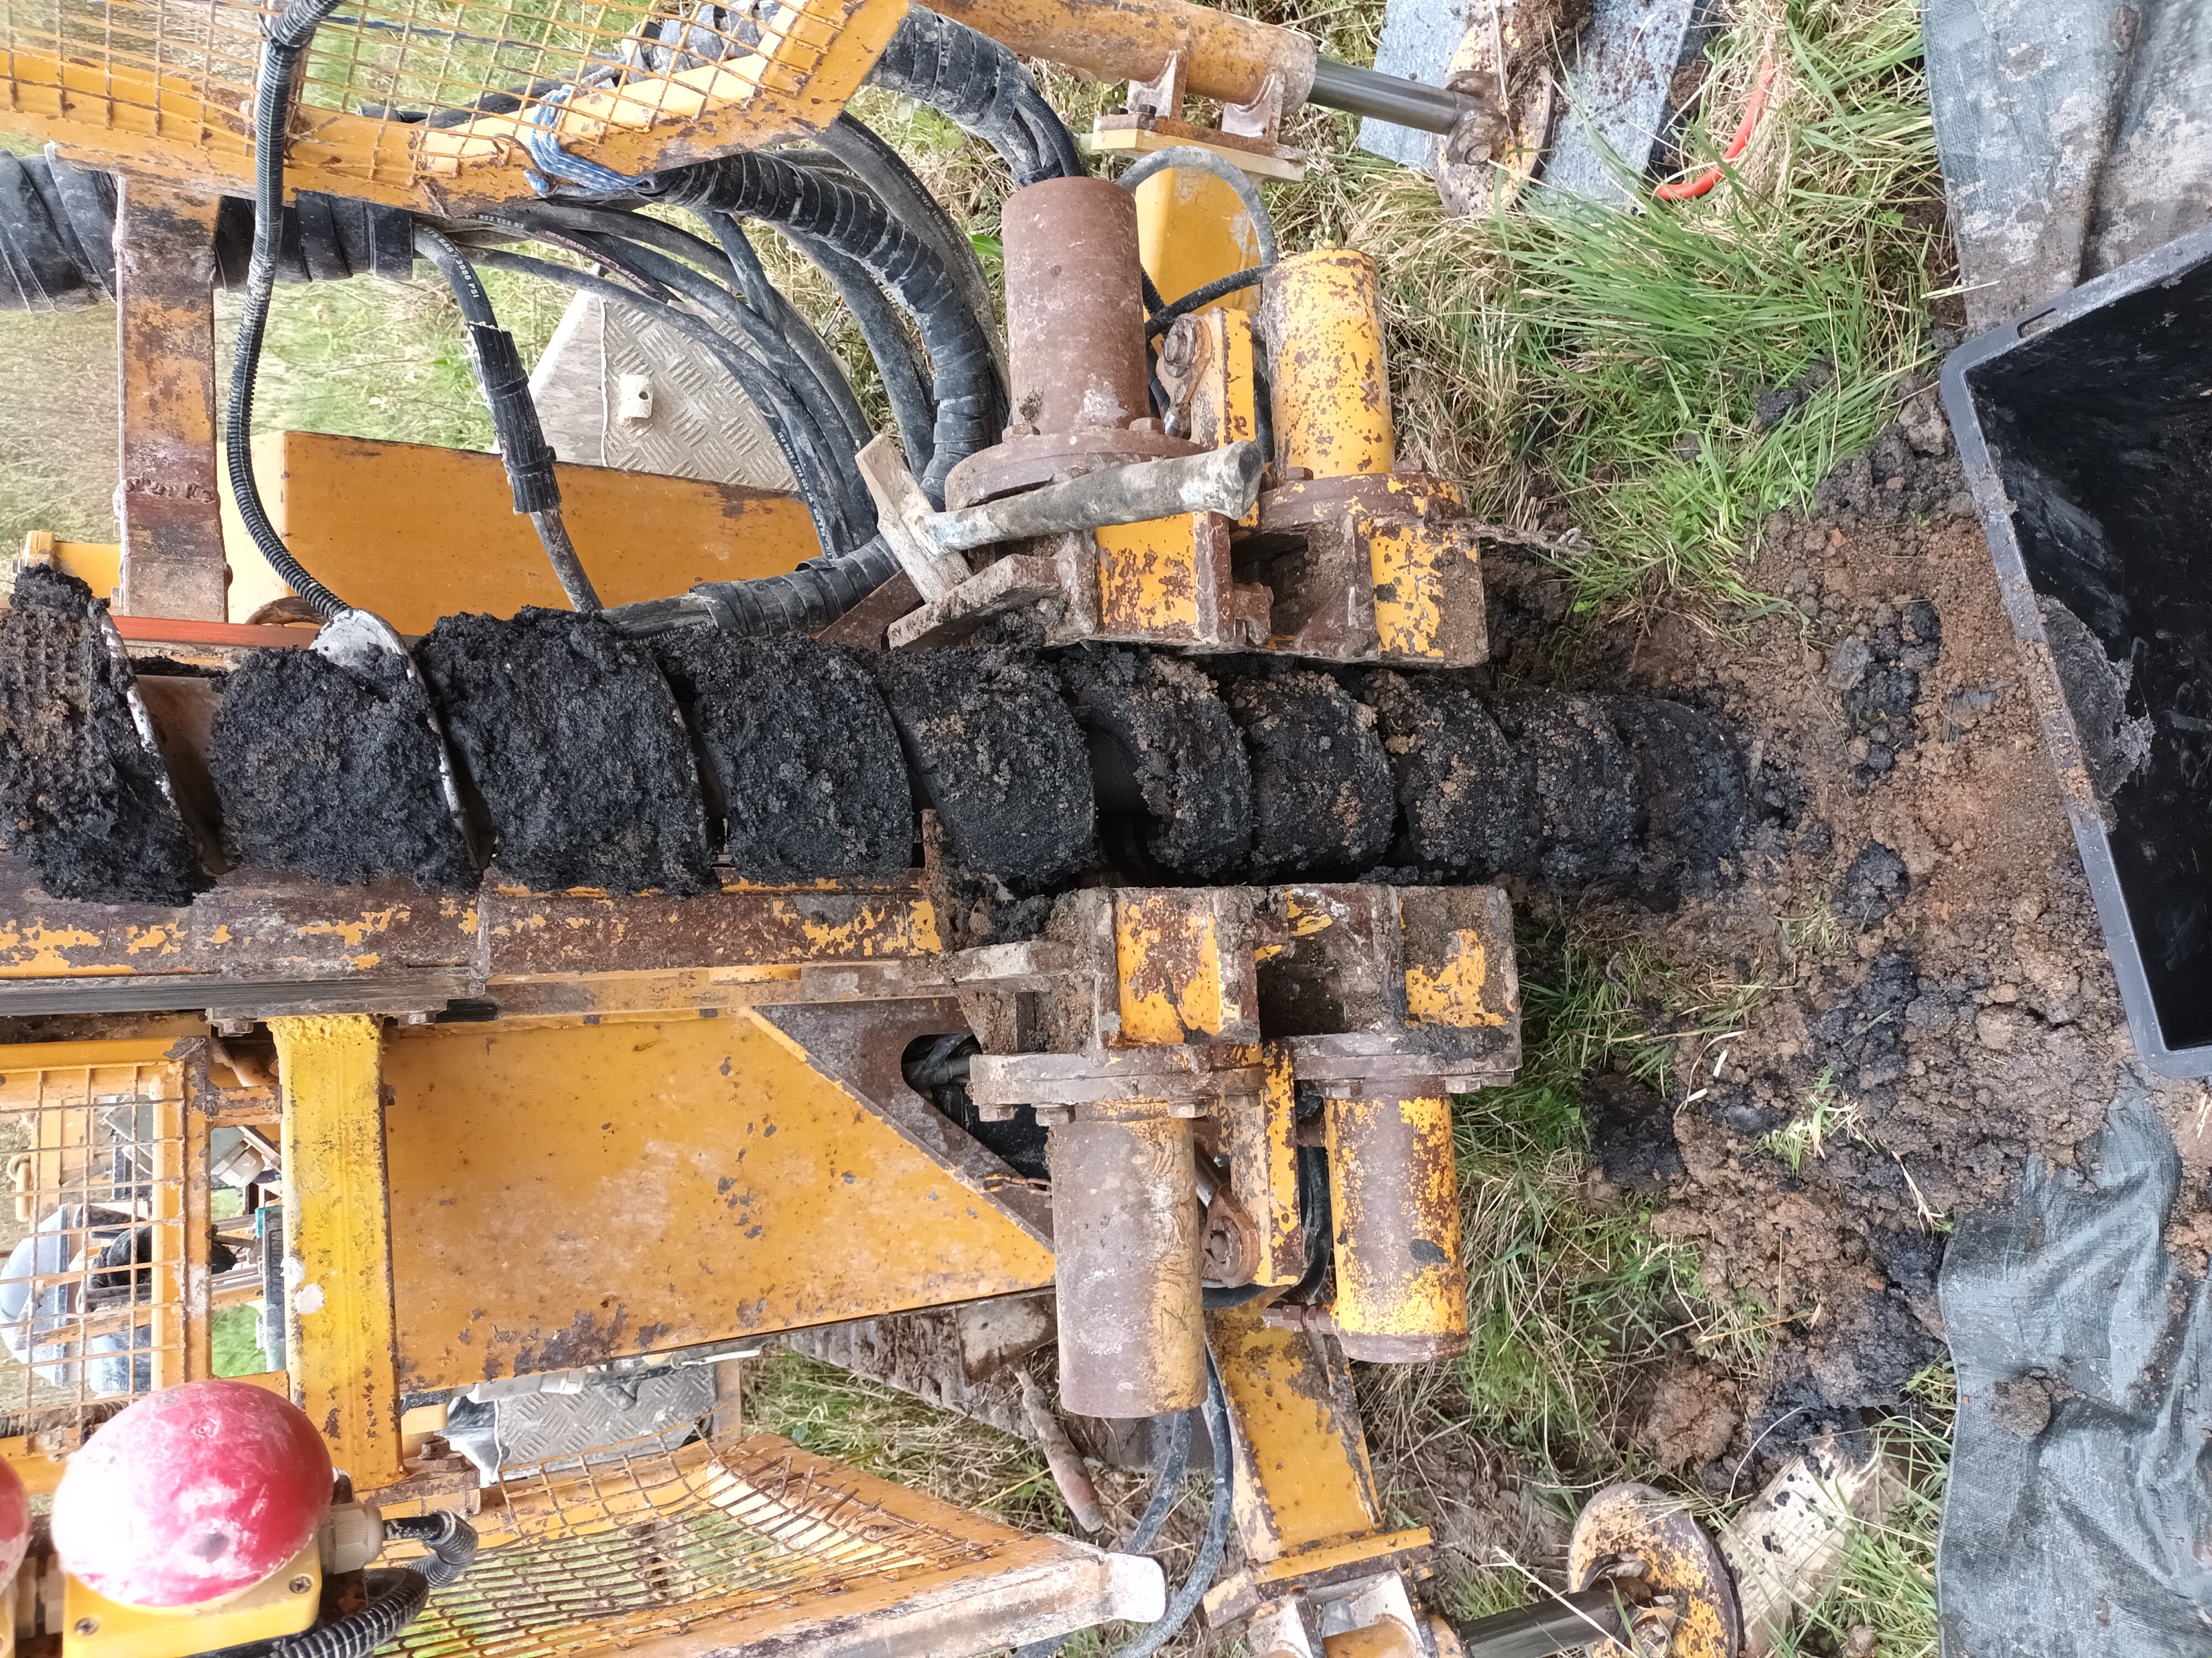
MIBIREM Sampling April 2023

Slide 8
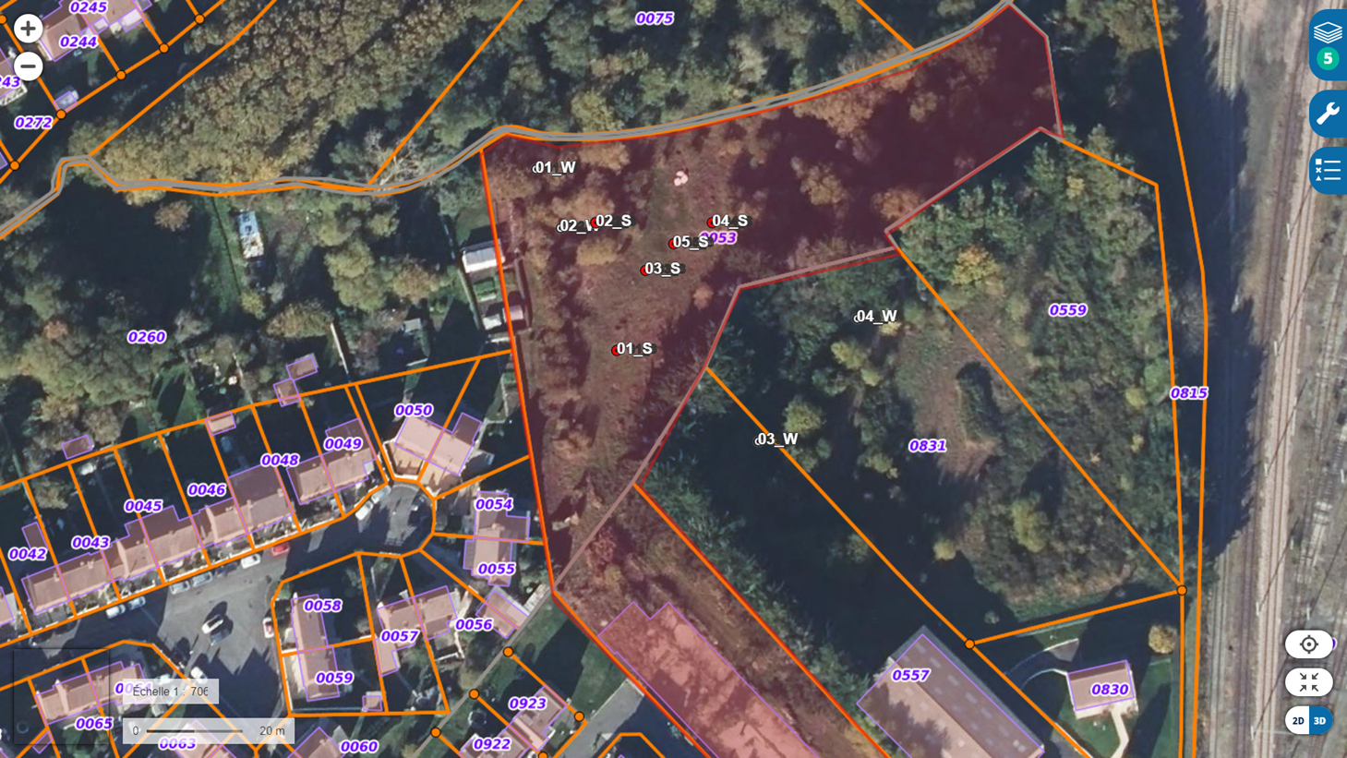
Legend
Renault-Lucienne site
Water samples
Soil samples
- 5 soil cores : 2 samples/core (0-2m and 2-4m)
- 4 groundwater samples

Slide 9
Legend
Renault-Lucienne site
Water samples
Too heavily contaminated with floating oil highly viscous : no water sampling
Soil samples
No TPH contamination
Floating oil layer of 20-30 cm
Groundwater PHC contamination

Slide 10
Legend
Renault-Lucienne site
Water samples
470
Soil samples
62000
63000
19000
3400
Surface soil PHC contamination

Slide 11
Legend
Renault-Lucienne site
Water samples
12000
Soil samples
2300
4800
840
160
Deep soil PHC contamination

